Slide 1
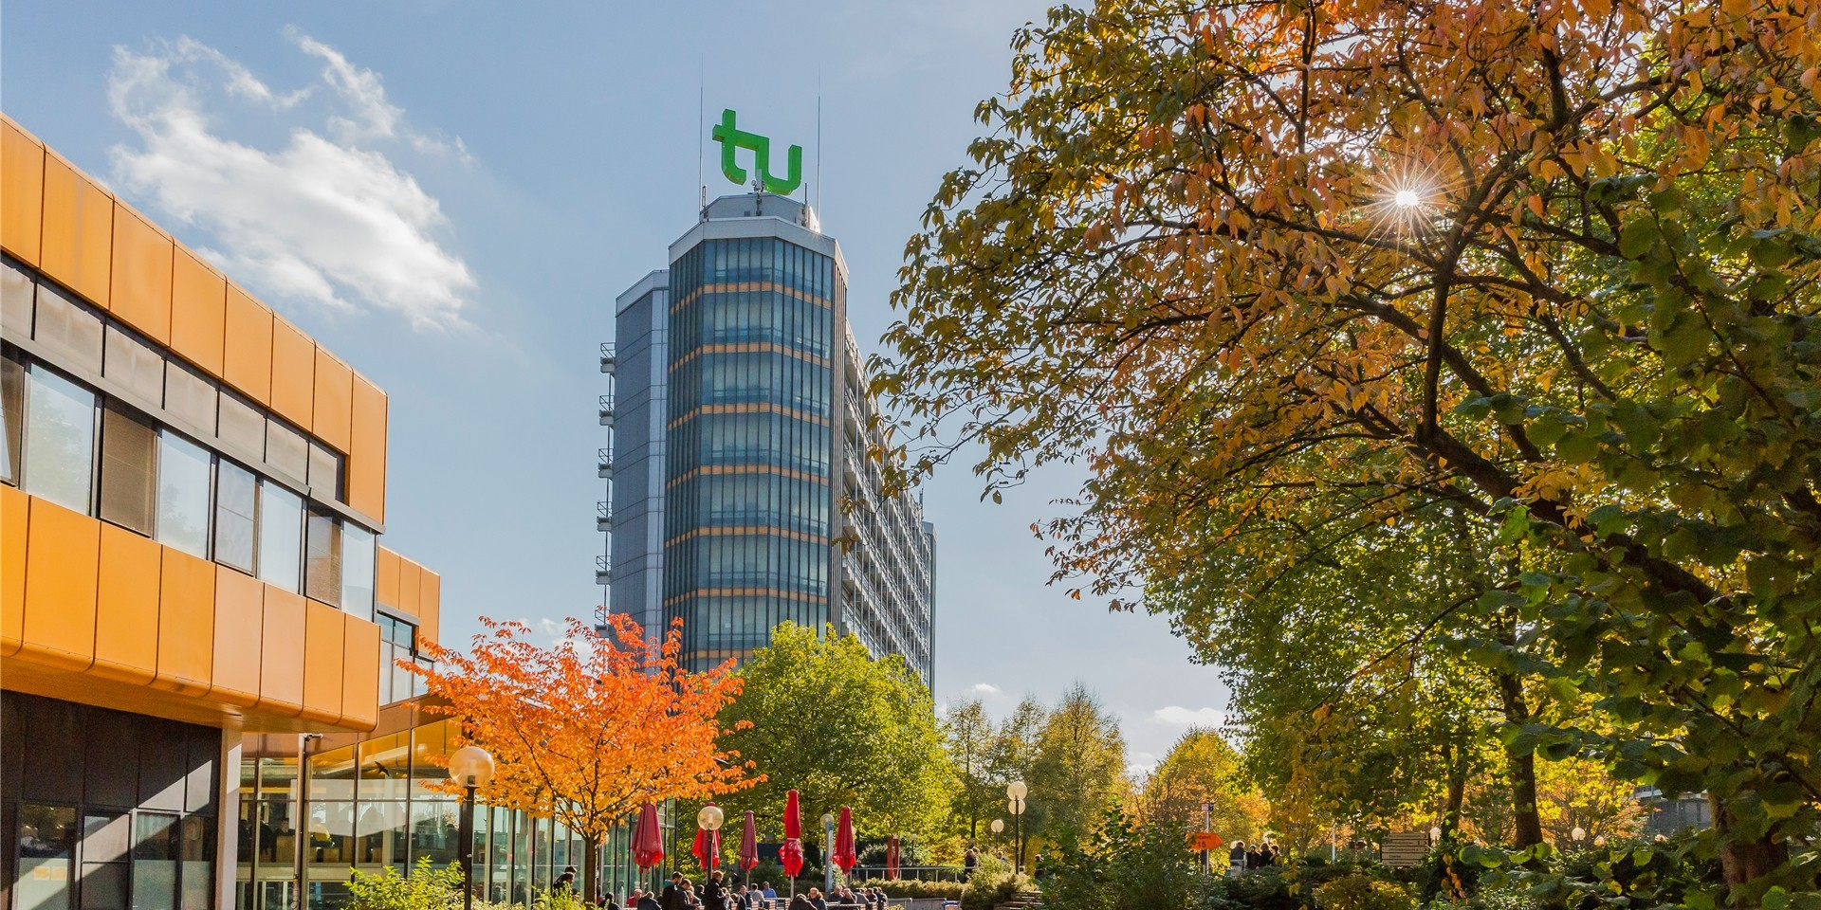
G1: Autoregressive Models

Slide 2
Content
Concept of Autoregression
Backward/Forward Pass
MADE:
Autoencoders
Distribution Estimation as Autoregression
Masked Autoencoder
Mask Generation
Training Methods for MADE
PixelCNN
Intro & Convolutional layer
Joint Distribution
Masked Convolutions
PixelCNN
PixelCNN & PixelRNN structure
PixelCNN vs PixelRNN

Slide 3
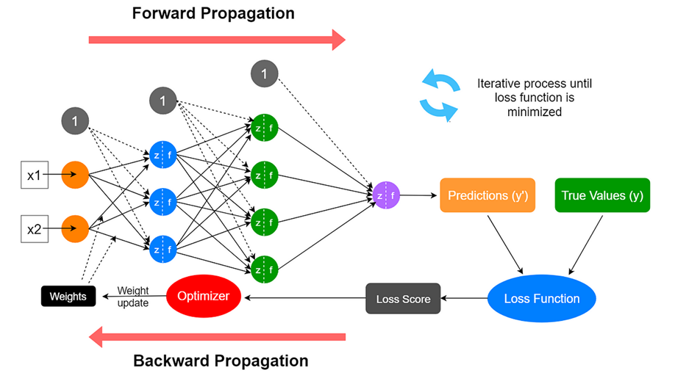
Backward/Forward Pass
https://medium.com/data-science-365/overview-of-a-neural-networks-learning-process-61690a502fa
Notes:
Was sind:
Forward Pass
Backward Pass
Forward Propagation
Backward Propagation:
Ablauf + Überleitung zur Mathematik hinter Backpropagation

Slide 4
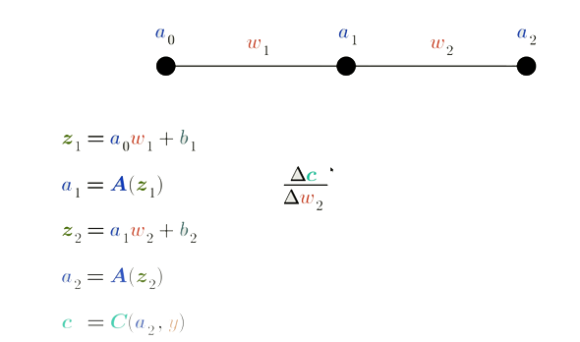
Backpropagation: Simple Example
Notes:
Setup: MLP & Formeln
Wie beeinflusst w2 die Costfunction?
Wie w2 verändern um Costfunction zu minimieren?

Slide 5
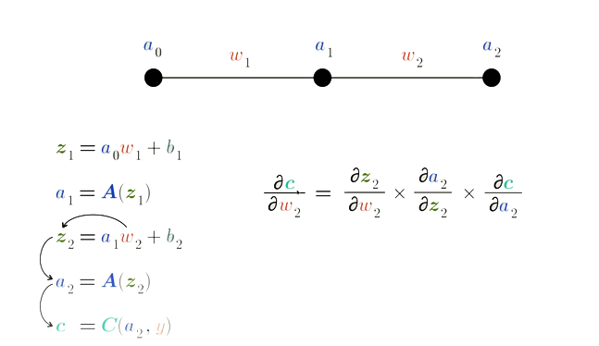
Backpropagation (2)
Notes:
Chain rule: Ableitungen in Teilableitungen aufteilen

Slide 6
Motivation for autoregressive models
Goal: estimate underlying distribution of data
Predict future values in sequential data by using past values (autoregression)

Slide 7
MADE
Masked Autoencoder for Distribution Estimation

Slide 8
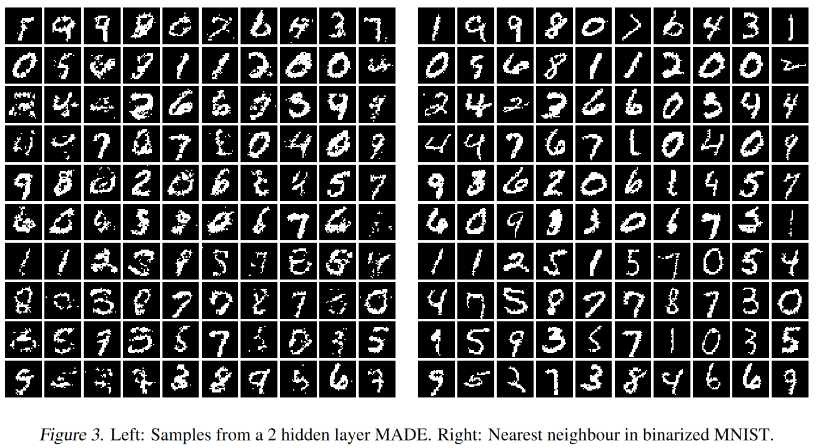
Motivation for MADE

Slide 9
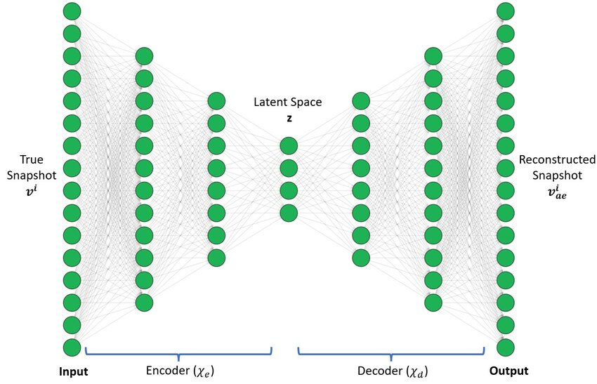
Goal: reconstruct input and learn compressed representation
Traditional autoencoders
https://www.researchgate.net/figure/MLP-Autoencoder-architecture_fig4_373266879
Notes:
Lernt komprimierte Repräsentation der Daten

Slide 10
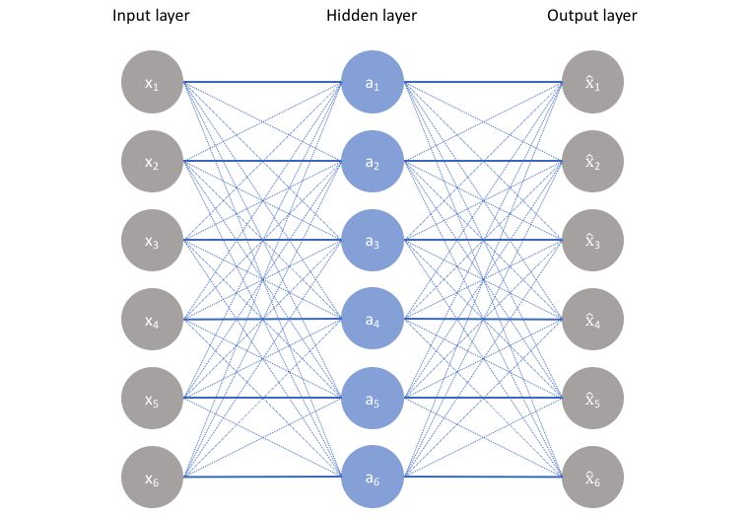
Constrain autoencoder to output data distribution(MADE)
Traditional Autoencoders(2)
Effective at capturing and representing data distributions implicitly
but only by applying constraints
Possible constraints:
Less connections
Less nodes
Add noise
https://www.jeremyjordan.me/autoencoders/
Notes:
Gefahr ohne constraints: Kopieren des Inputs

Slide 11
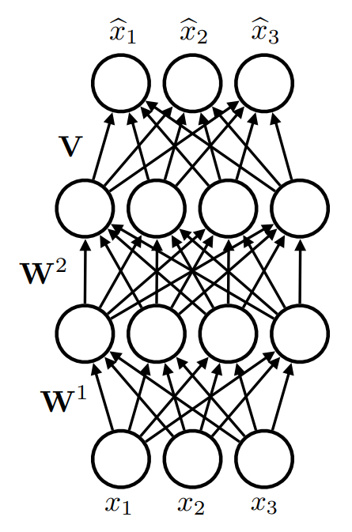
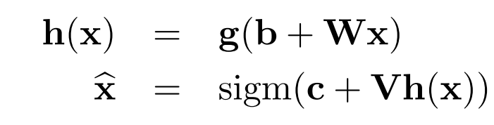
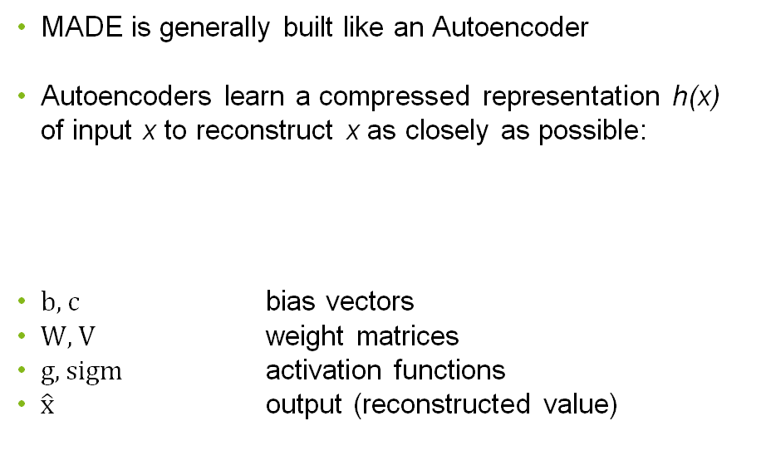
Architecture of MADE
MADE is generally built like an Autoencoder
Autoencoders learn a compressed representation h(x) of input x to reconstruct x as closely as possible:
$b,c$ bias vectors
$W, V$ weight matrices
$g, sigm$ activation functions
$\hat{x}$ output (reconstructed value)

Slide 12
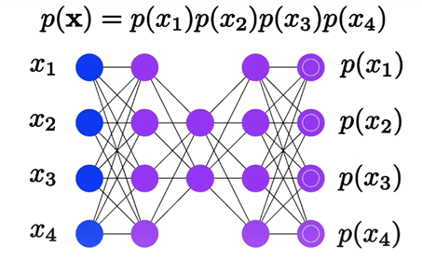
First attempt
output is probabilty
→ joint distribution p(x)
but this uses i.i.d assumption
https://towardsdatascience.com/made-masked-autoencoder-for-distribution-estimation-fc95aaca8467
Notes:
Gemeinsame Verteilung= Mult. der einzelnen Wahrscheinlichkeiten

Slide 13
In our networks not the case
i.i.d. assumption
i.i.d. means independent identically distributed
Independent: one sample does not influence others
Identically distributed: all samples come from the same probability distribution
Notes:
Wir haben in unserem Fall voneinander abhängige Samples
Wird im Übergang von Autoencoder zu Masked Autoencoder nochmal relevant

Slide 14
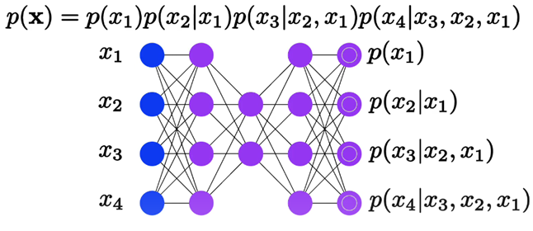
Ordering of data is arbitrary(order agnostic training)
(almost) MADE structure
https://towardsdatascience.com/made-masked-autoencoder-for-distribution-estimation-fc95aaca8467
Notes:
(Danach Wechsel)

Slide 15
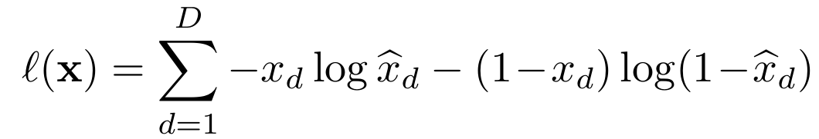
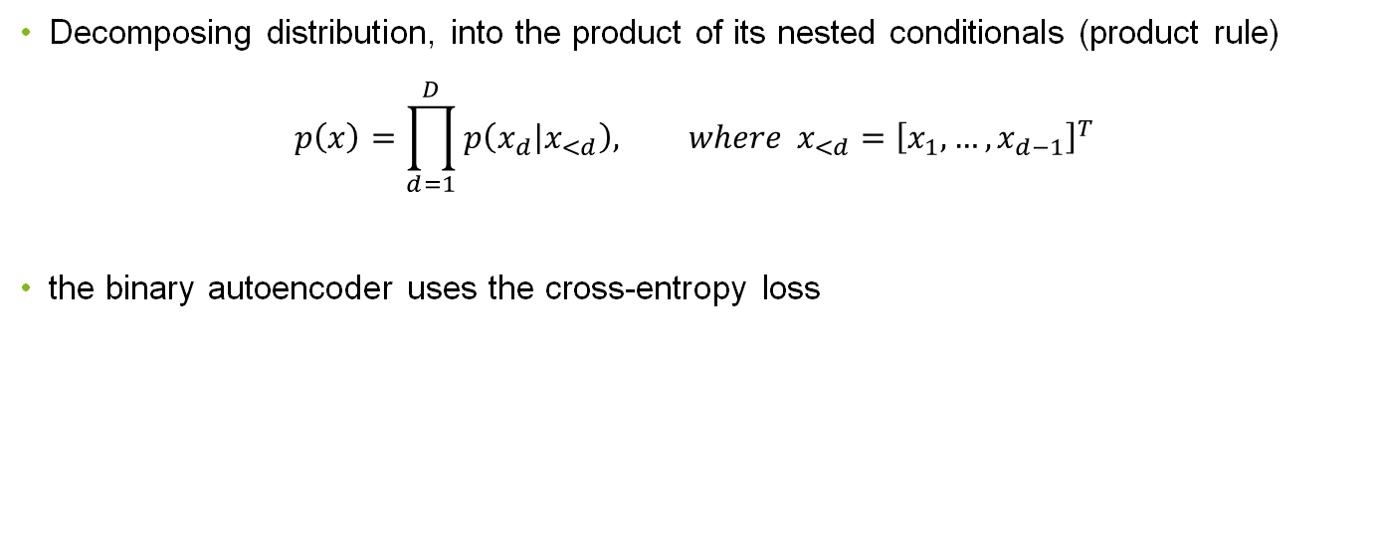
MADE
Decomposing distribution, into the product of its nested conditionals (product rule)
$$p\left(x\right)=\prod_{d=1}^{D}{p\left(\left.x_{d}\right|x_{<d}\right), where }x_{<d}={\left[x_{1},…,x_{d−1}\right]}^{T}$$
the binary autoencoder uses the cross-entropy loss
Notes:
Main Disadvantage: The representation it learns can be trivial
if the hidden layer is at least as large as the input, hidden units can each learn to “copy” a single input dimension

Slide 16
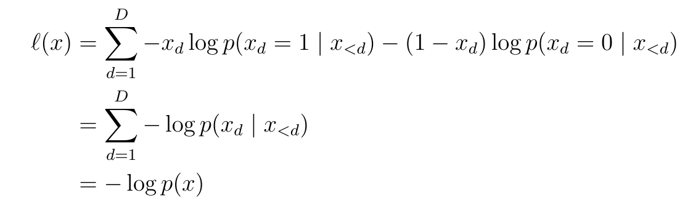
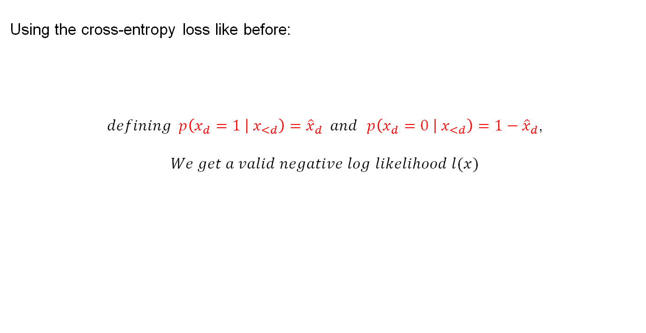
Using the cross-entropy loss like before:
$defining p\left(x_{d}=\left.1 \right|{ x}_{<d}\right)={\hat{x}}_{d} and$ $p\left(x_{d}=\left.0 \right|{ x}_{<d}\right)=1−{\hat{x}}_{d}$,
$We get a valid negative log$ $likelihood l(x)$
Notes:
Durch einsetzen von 0 bzw 1 für x_d fällt der jeweilige Teil weg

Slide 17
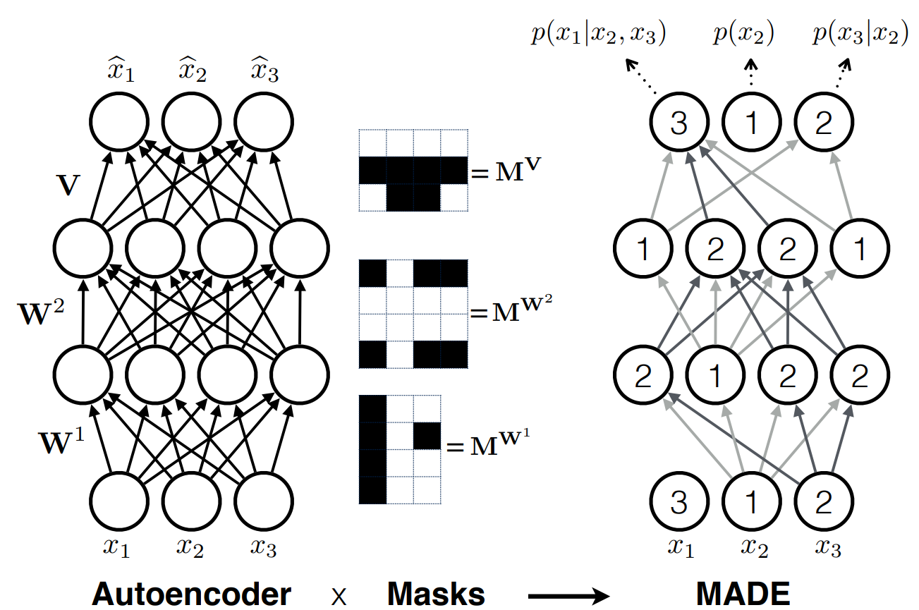
Goal: Erase all non-autoregressive connections (logically)
Masked Autoencoder: Intuition
Gruppe 1 Fachprojekt Machine Learning | Autoregressive Models
Notes:
Schwarz=0 -> connection fällt weg

Slide 18
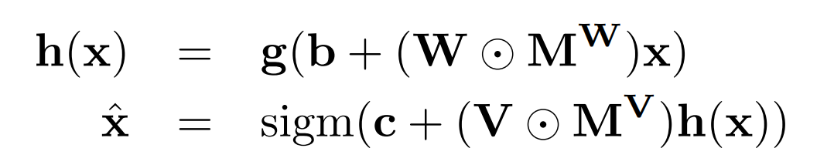
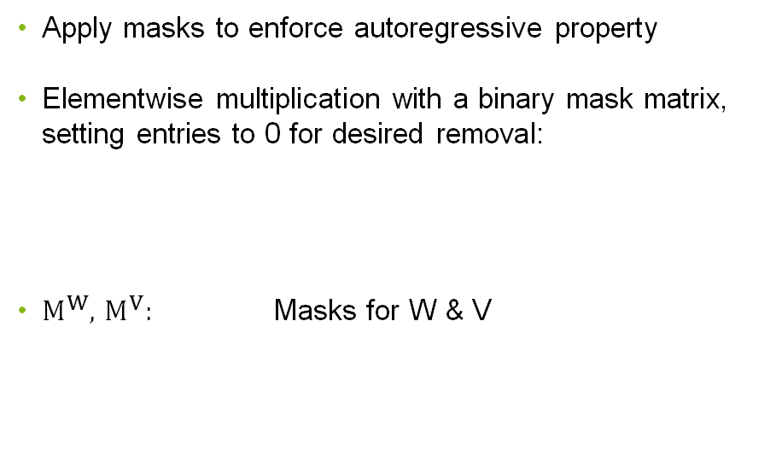
Masked Autoencoder
Apply masks to enforce autoregressive property
Elementwise multiplication with a binary mask matrix, setting entries to 0 for desired removal:
$M^{W}$, $M^{V}$: Masks for W & V
Notes:
Keine connections zu zukünftigen daten
Nur logisches Entfernen der connections

Slide 19
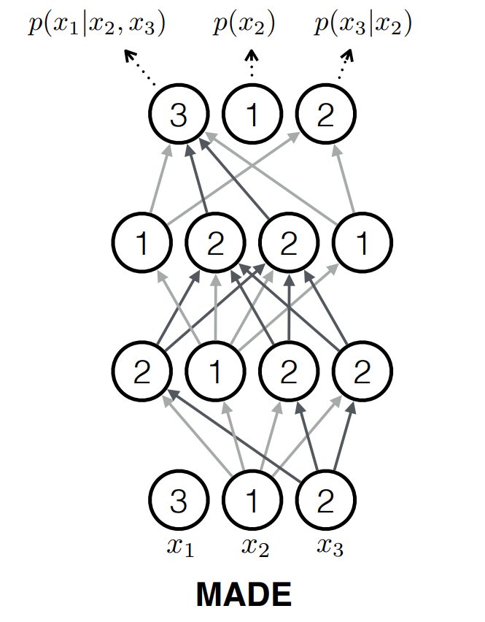
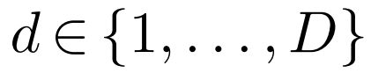
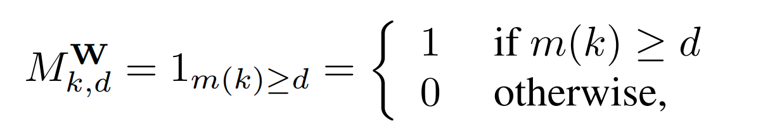
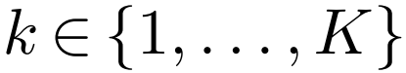
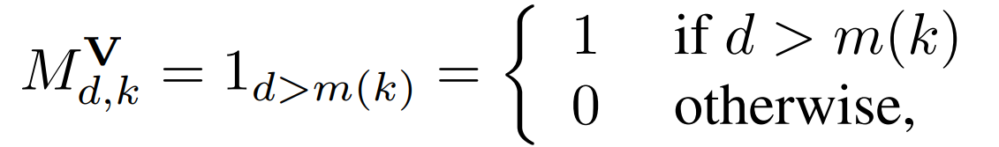
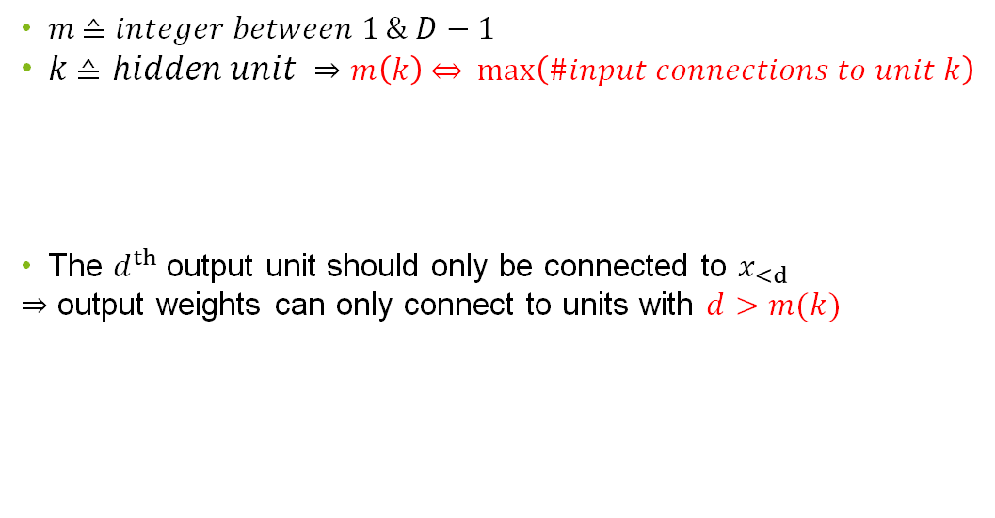
Mask generation: Constraints
$m \text{≙} integer between 1 \& D−1$
$k \text{≙} hidden unit$ ⇒ $m\left(k\right) \text{⇔}\max\left(\#input connections to unit k\right)$
The $d^{th}$ output unit should only be connected to $x_{<d}$
⇒ output weights can only connect to units with $d>m(k)$
d
m(k)
d
Notes:
Disallow m(k) = D since this hidden unit would depend on all inputs, m(k) = 0 also disallowed, as it would create constant hidden units
No connection to first output x2 as desired

Slide 20
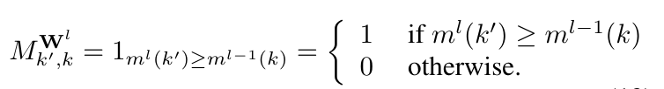
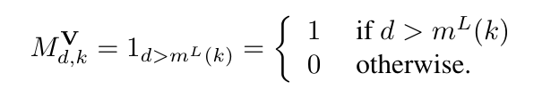
Extension to Deep Networks
Network with l layers
Layer 0,…,l-1
Output layer
Reference:
Notes:
Avoid unconnected nodes --> sample m(k) now from min(m_k from prev. layer) ,…,D-1

Slide 21
Using both results in an overall better performance
Training Methods for MADE
Order-Agnostic Training
Training on all orderings of the input
Missing values can be easily computed
Ensemble of models with different orderings and averaging
Connectivity-Agnostic Training
Connectivity pattern is randomly sampled for each training example
NN needs to be more robust → better results
Notes:
(order)Missing values are dependent on all observed ones
(connectivity) don’t sample from all patterns just a finite list of precomputed masks

Slide 22
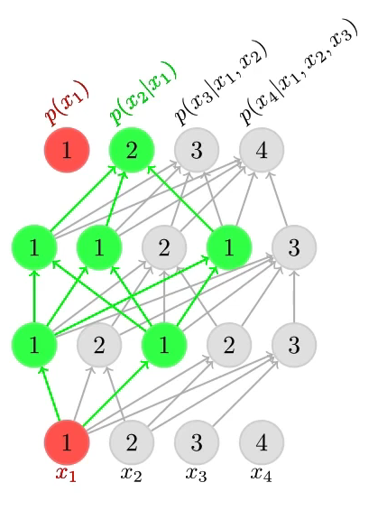
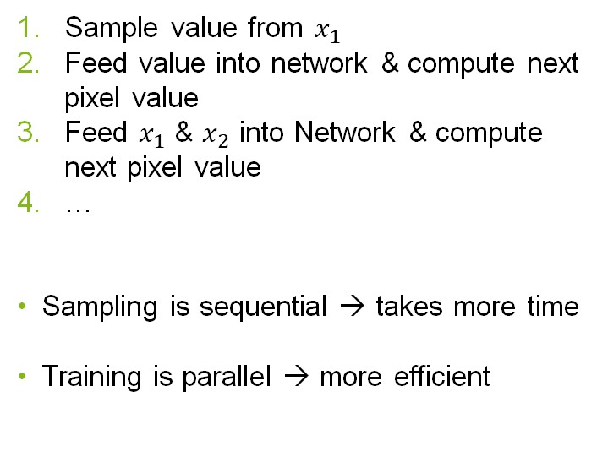
MADE: Sampling
Sample value from $x_{1}$
Feed value into network & compute next pixel value
Feed $x_{1}$ & $x_{2}$ into Network & compute next pixel value
…
Sampling is sequential → takes more time
Training is parallel → more efficient
https://youtu.be/lNW8T0W-xeE?si=LgUjyPHeKFvK0xkc
Notes:
(Danach Wechsel)

Slide 23
PixelCNN & PixelRNN
Pixel Convolutional Neural Networks &
Pixel Recurrent Neural Networks

Slide 24
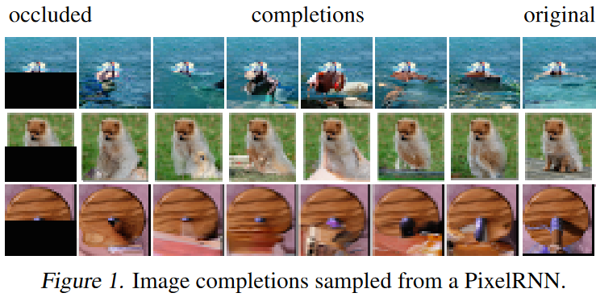
PixelCNN & PixelRNN: Intro
Goal: model the distribution of natural images
models should be tractable and scalable
Usage: Image completion or sample new images

Slide 25
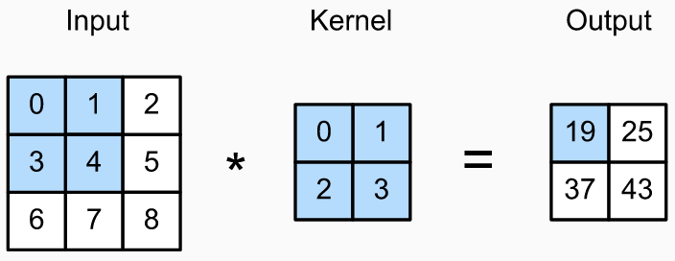
General Concept of Convolution
Filter/ Kernel: (weight) matrix used for convolution
Stride: step width of the filter
Padding: preserve spatial dimensions by adding zeros around the input
https://bios691-deep-learning-r.netlify.app/class/04-class/
Notes:
Zusatzinfo (nicht unbedingt erwähnen):
Input: C_in * H * W
Output size: C_out * H‘ * W‘
H‘ = (H – K + 2P) / S + 1
W‘ = (W – K + 2P) / S + 1

Slide 26
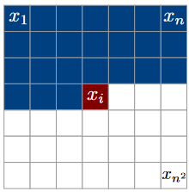
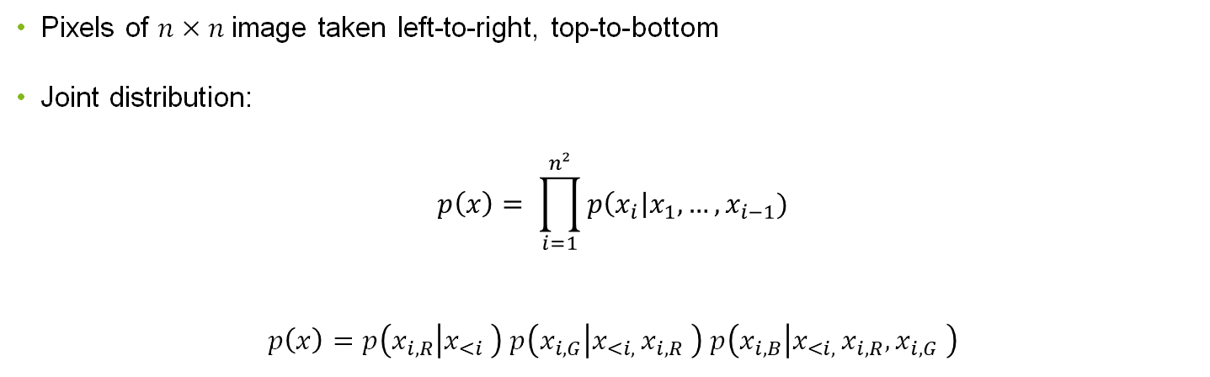
Each pixel depends on previous pixels (also in different channels)
PixelCNN/PixelRNN: joint distribution
Pixels of $n×n$image taken left-to-right, top-to-bottom
Joint distribution:
$$p\left(x\right)= \prod_{i=1}^{n²}{p\left(x_{i}\right|x_{1},…,x_{i−1})}$$
$$p\left(x\right)=p\left(x_{i,R} | x_{<i} \right) p\left(x_{i,G} | x_{<i, }x_{i,R} \right) p\left(x_{i,B} | x_{<i, }x_{i,R},x_{i,G} \right)$$

Slide 27
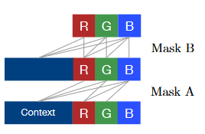
Masked Convolutions
Masks are applied to convolutions to avoid seeing future context
Pixel dependencies are kept
Two types of masks (A & B)

Slide 28
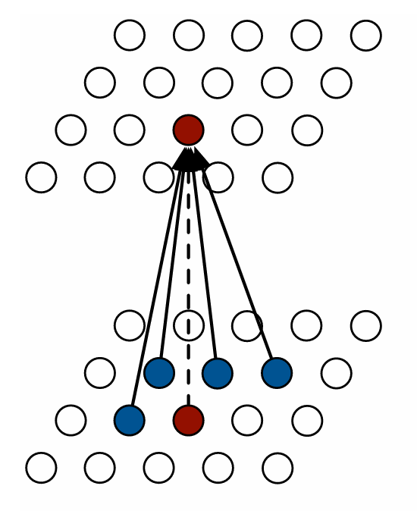
Masked Convolutions: Mask A
Applied to first convolution filter
Restricts connections to previous pixels and colo urs of the current pixels that have already been predicted
Masked out because they haven‘t been generated yet
Notes:
Green depends on red, blue depends on green and red

Slide 29
Masked Convolutions: Mask B
Applied to subsequent input-to-state convolutional transitions
Allows a connection from a colour to itself

Slide 30
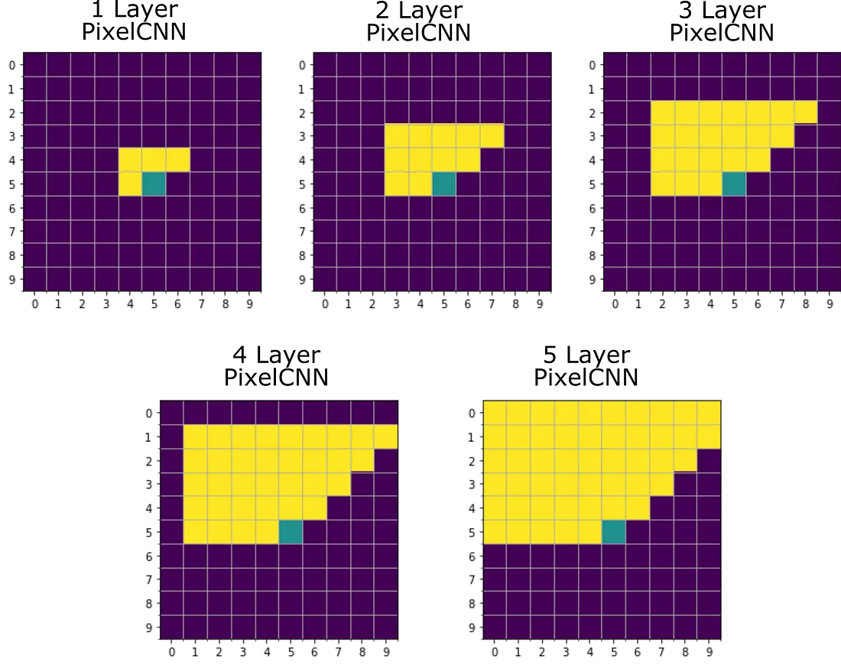
PixelCNN
https://miro.medium.com/v2/resize:fit:1100/format:webp/1*V0V1blD6mdGkPmYDede3dw.png
Notes:
Size of receptive field gets larger with more layers
Receptive field size depends on #layers -> bounded receptive field
Receptive field does not capture all available context

Slide 31
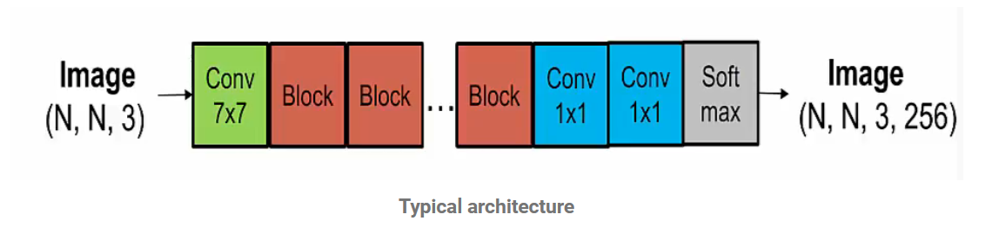
Structure: PixelCNN/PixelRNN
https://neuroverse0.wordpress.com/2020/08/11/pixelrnn-gated-pixelcnn-and-pixelcnn/
Notes:
Netzwerk besteht aus mehreren Schichten
Input ist ein Bild mit 3 Farbkanälen
Am anfang 7x7 convolution
Dann mehrere residual Blöcke (genaueres auf nächster Folie)
Dann 2 convolutional layers
Und am ende der Softmax, sodass für jeden Farbkanal eine Distribution ausgegeben wird

Slide 32
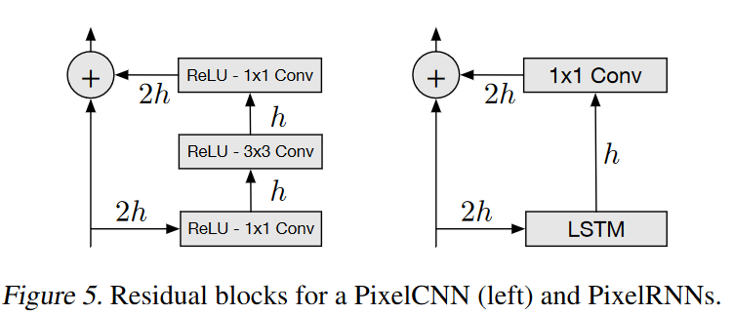
PixelCNN: residual block
Input map is added to the output map
Goal: increase convergence and propagate signals more directly
Notes:
(Danach Wechsel)

Slide 33
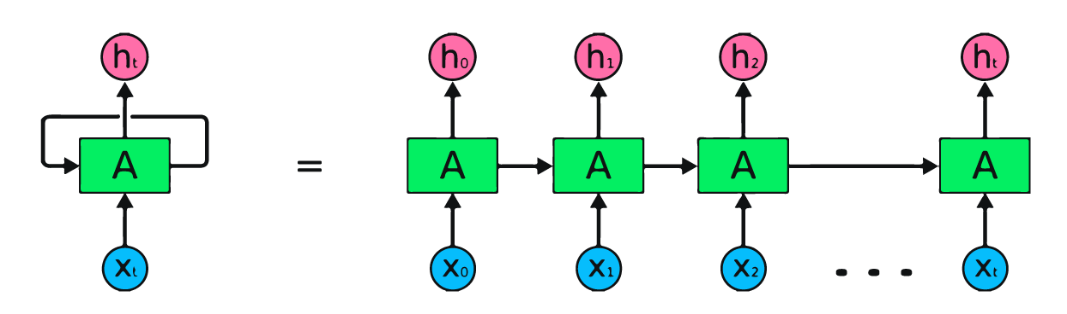
https://images.datacamp.com/image/upload/v1647442110/image2_ysmali.png
Recurrent Neural Networks (RNN)
Notes:
Output of nn is fed into the input again, instead of to the next layer

Slide 34
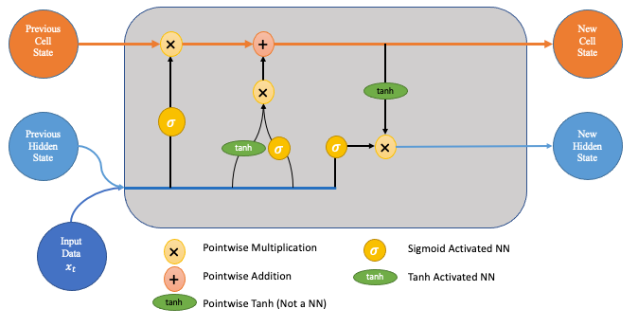
https://towardsdatascience.com/lstm-networks-a-detailed-explanation-8fae6aefc7f9
LSTM(Long short-term memory)
A special kind of Recurrent Neural Network (RNN) that are designed to learn long-term dependencies in sequence data
Components of LSTM:
Input-to-state
State-to-state
Four gates (output, input, forget, content)
Notes:
Forget Gate -> Wie viel vom alten Cell State?
Input Gate -> Wie viel vom aktuellen input in den neuen Cell State?
Output Gate -> Kombination input & prev. Cell State

Slide 35
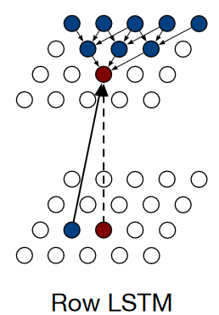
PixelRNN: Row LSTM
Unidirectional layer
Processes image row by row
Triangular receptive field (missing available context)
Notes:
Maske ist 3x1

Slide 36
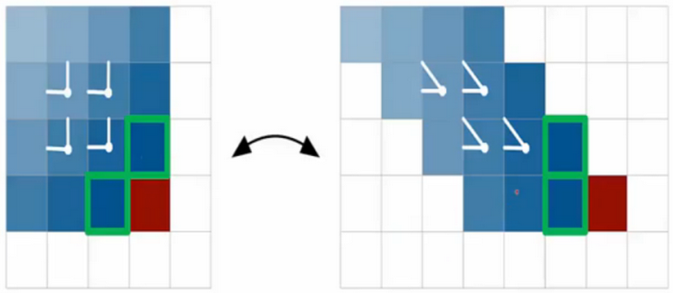
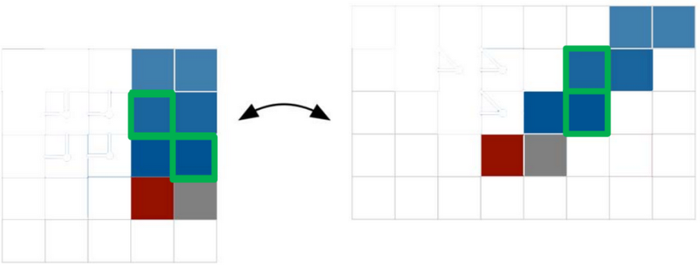
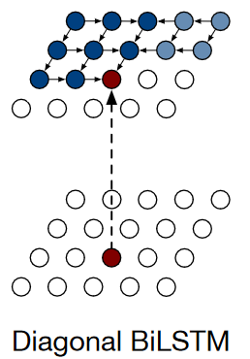
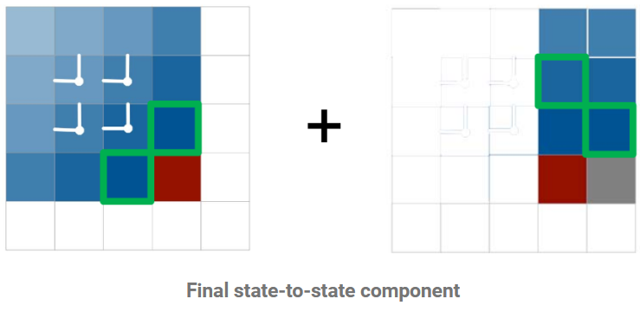
PixelRNN: Diagonal BiLSTM
Captures entire available context
Scans image in diagonal from the top corners
https://neuroverse0.wordpress.com/2020/08/11/pixelrnn-gated-pixelcnn-and-pixelcnn/
Notes:
Input map is skewed to apply convolutions (1x2 mask) along diagonals
At the end: right output map is added to the left output map

Slide 37
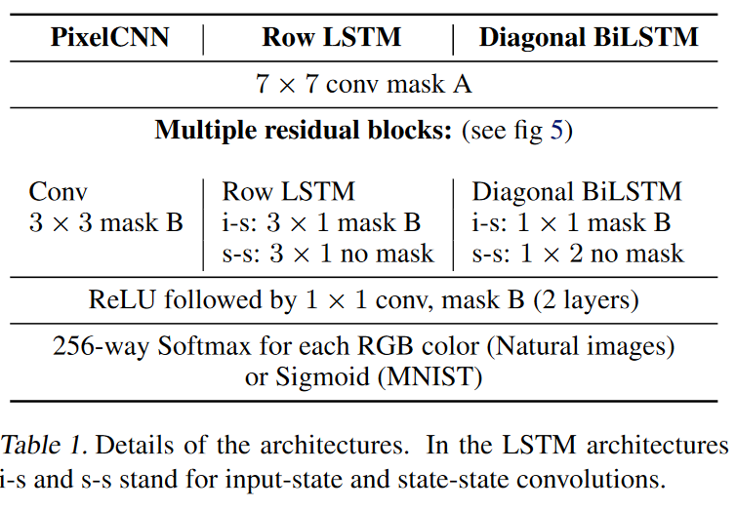
Structure: PixelCNN vs PixelRNN

Slide 38
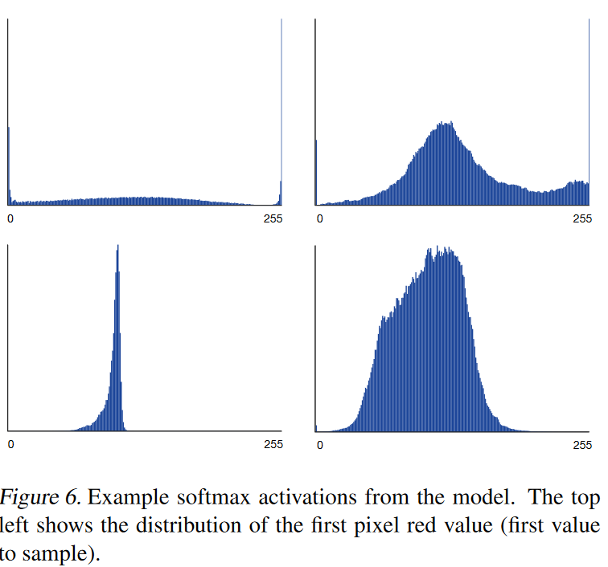
PixelCNN/RNN: output
256-way Softmax for each RGB colour
Softmax model discrete probability distribution
Advantages: distribution mass inside [0,255] ; predicted distributions are meaningful
Notes:
Predicted distributions are meaningfull: e.g. 0 und 255 haben oft hohe Wahrscheinlichkeit, da sie auch häufiger vorkommen

Slide 39
PixelCNN vs PixelRNN
PixelRNN
Uses LSTMs to capture dependencies
Computational more intensive in training
→ each state needs to be computed sequentially
Captures entire available context
PixelCNN
Only uses convolutional layers
Computational more efficient in training/evaluation
→ computes features for all pixel positions at once
Limited receptive field (not all available context captured)

Slide 40
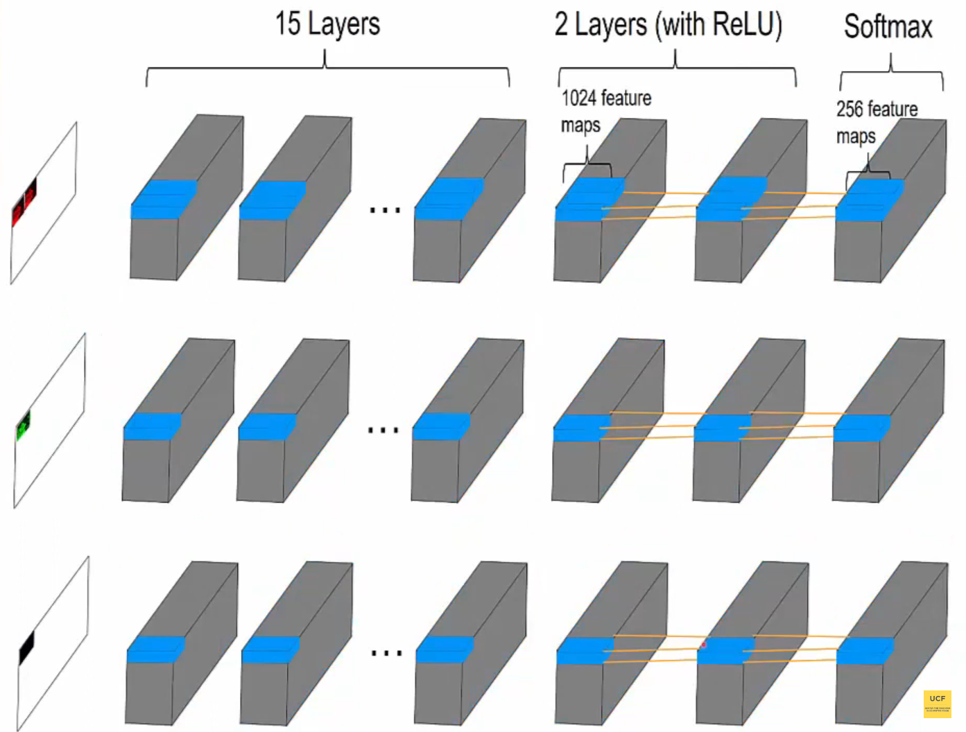
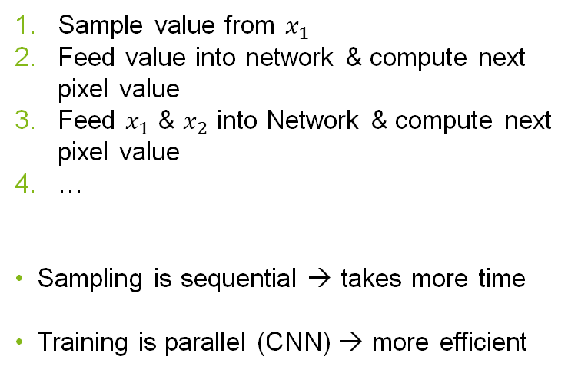
PixelCNN: Sampling
Sample value from $x_{1}$
Feed value into network & compute next pixel value
Feed $x_{1}$ & $x_{2}$ into Network & compute next pixel value
…
Sampling is sequential → takes more time
Training is parallel (CNN) → more efficient
https://youtu.be/-FFveGrG46w?si=BOHiIvvzY-GnDJgU
Notes:
Every pixel has to wait for the prev pixel green waits for red
Blue waits for green and red

Slide 41
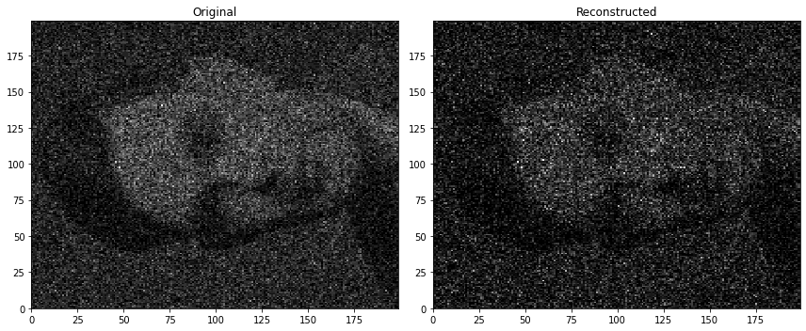


Generated from ImageNet
MADE vs PixelRNN/CNN

Slide 42
Appendix

Slide 43
Sources
Pixel Recurrent Neural Networks – Google DeepMind
MADE: Masked Autoencoder for Distribution Estimation - Mathieu Germain
https://medium.com
https://miro.medium.com
https://youtu.be/hfMk-kjRv4c?si=UGt55n13H9mIYcJa - Sebastian Lauge
https://youtu.be/tIeHLnjs5U8?si=5IEHnfWKft9AT6lP – 3Blue1Brown
MADE - blog by Kapil Sachdeva
https://bios691-deep-learning-r.netlify.app/class/04-class
https://neuroverse0.wordpress.com/2020/08/11/pixelrnn-gated-pixelcnn-and-pixelcnn
https://images.datacamp.com/image/upload/v1647442110/image2_ysmali.png
https://towardsdatascience.com/lstm-networks-a-detailed-explanation-8fae6aefc7f9
https://www.jeremyjordan.me/autoencoders
https://www.researchgate.net/figure/MLP-Autoencoder-architecture_fig4_373266879

Slide 44


Slide 45



